Slide 1


Protecting App Secrets with .NET Core & Azure
Scott Addie | @Scott_Addie | Senior Content Developer

Slide 2


























Swag Bags
Platinum Sponsors
Lanyards
Party
Gold Sponsors
Notebooks
Media

Slide 3
Agenda
Identify the problem
Solutions
Secret Manager
Azure Key Vault
Comparison of solutions
Demo

Slide 4

> git add .
> git commit –m “Add connection string to appsettings.json”
> git push origin master
> asdfkasdfkjlasdflkhadfgjfg
appsettings.json
{ "ConnectionStrings": { "Movies": "Server=(localdb)\\mssqllocaldb;Database=Movie-1;User Id=johndoe;Password=pass123;MultipleActiveResultSets=true" } }
Notes:
“Meet John: an overworked, underpaid developer fueled by caffeine and pizza.”

Slide 5

The next morning…
Ugh, this is bad!
It appears so…
Did John push his credentials to the repo last night?

Slide 6
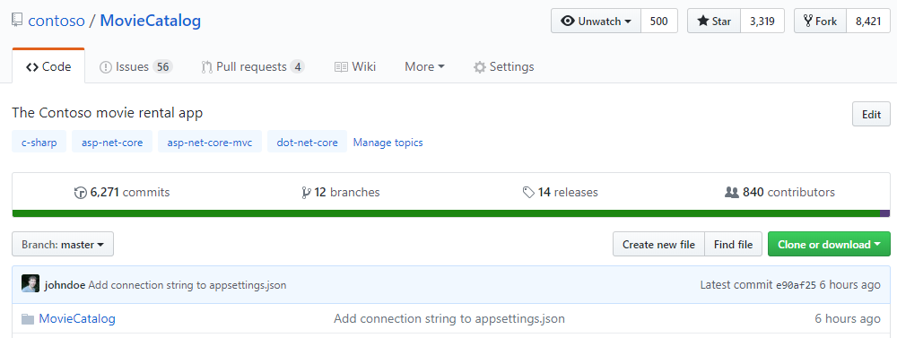
A ticking time bomb in a public repo…

Slide 7
Problem statements
Developer:
“I want my ASP.NET Core app’s sensitive configuration data to be protected, without having to write the code myself.”
CISO:
“I want to know that our apps comply with FIPS 140-2 Level 2 HSMs for secure key management.”
Notes:
FIPS = Federal Information Processing Standard

Slide 8
Secret Manager
CLI
IDE
Prerequisites
.NET Core SDK v2.1+
Usage
> dotnet user-secrets
Prerequisites
.NET Core SDK v2.1+
VS 2017 15.7+
.NET Core cross-platform development
ASP.NET and web development
Usage
Solution Explorer > right-click project > Manage User Secrets
Notes:
VS SUPPORT
.NET Core support ONLY in 15.7 (secrets.json)
.NET Framework support in 15.8 (secrets.xml)
.NET Core SDK 2.1.300 bundles user-secrets command

Slide 9



Secret Manager: .NET Core CLI
> dotnet user-secrets set “Movies:Password” “pass123”
> dotnet user-secrets set “Movies:User” “johndoe”
MovieCatalog.csproj
<Project Sdk="Microsoft.NET.Sdk.Web"> <PropertyGroup> <TargetFramework>netcoreapp2.1</TargetFramework> <UserSecretsId>0087f3aa-237b-4c08-a9dc-5927be11eadd</UserSecretsId> </PropertyGroup>
secrets.json
~/.microsoft/usersecrets/<id>/
{ "Movies:Password": "pass123", "Movies:User": "johndoe" }
%APPDATA%\Microsoft\UserSecrets\<id>\

Slide 10
Secret Manager: Retrieval
Startup.cs
public class Startup { private string _connection = null; public Startup(IConfiguration configuration) => Configuration = configuration; public IConfiguration Configuration { get; } public void ConfigureServices(IServiceCollection services) { var builder = new SqlConnectionStringBuilder( Configuration.GetConnectionString("Movies")); builder.UserID = Configuration["Movies:User"]; builder.Password = Configuration["Movies:Password"]; _connection = builder.ConnectionString;

Slide 11
Azure Key Vault
CLI
IDE
Prerequisites
Azure subscription
Azure CLI
Usage
> az keyvault
Prerequisites
Azure subscription
.NET Core SDK v2.1+
VS 2017 15.7+
.NET Core cross-platform development
ASP.NET and web development
Usage
Solution Explorer > double-click Connected Services > Secure Secrets with Azure Key Vault
Notes:
- Azure Cloud Shell ← the best CLI is the one you don’t have to install
- VS 15.7 introduces Connected Services node Key Vault creation
- Key Vault takes precedence over Secret Manager at runtime, since it’s more secure

Slide 12
Key Vault: Azure CLI
> az keyvault create --name `MoviesVault`
--resource-group `MoviesRG`
--location eastus
> az keyvault secret set --vault-name `MoviesVault`
--name `Password`
--value `pass123`
> az keyvault secret set --vault-name `MoviesVault`
--name `User`
--value `johndoe`

Slide 13
Key Vault: Retrieval
ASP.NET Core app:
Index.cshtml
@page @model IndexModel @inject Microsoft.Extensions.Configuration.IConfiguration config <strong>Username:</strong> @config["User"] <strong>Password:</strong> @config["Password"]

Slide 14
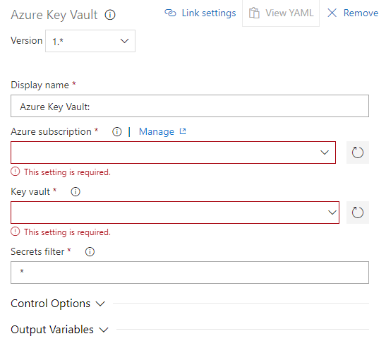

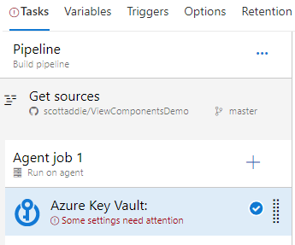
Key Vault: Retrieval (cont.)
Azure Pipelines build:
Azure Key Vault task
Notes:
Download secrets from key vault with build task
Can use secrets as task variables in other build tasks

Slide 15
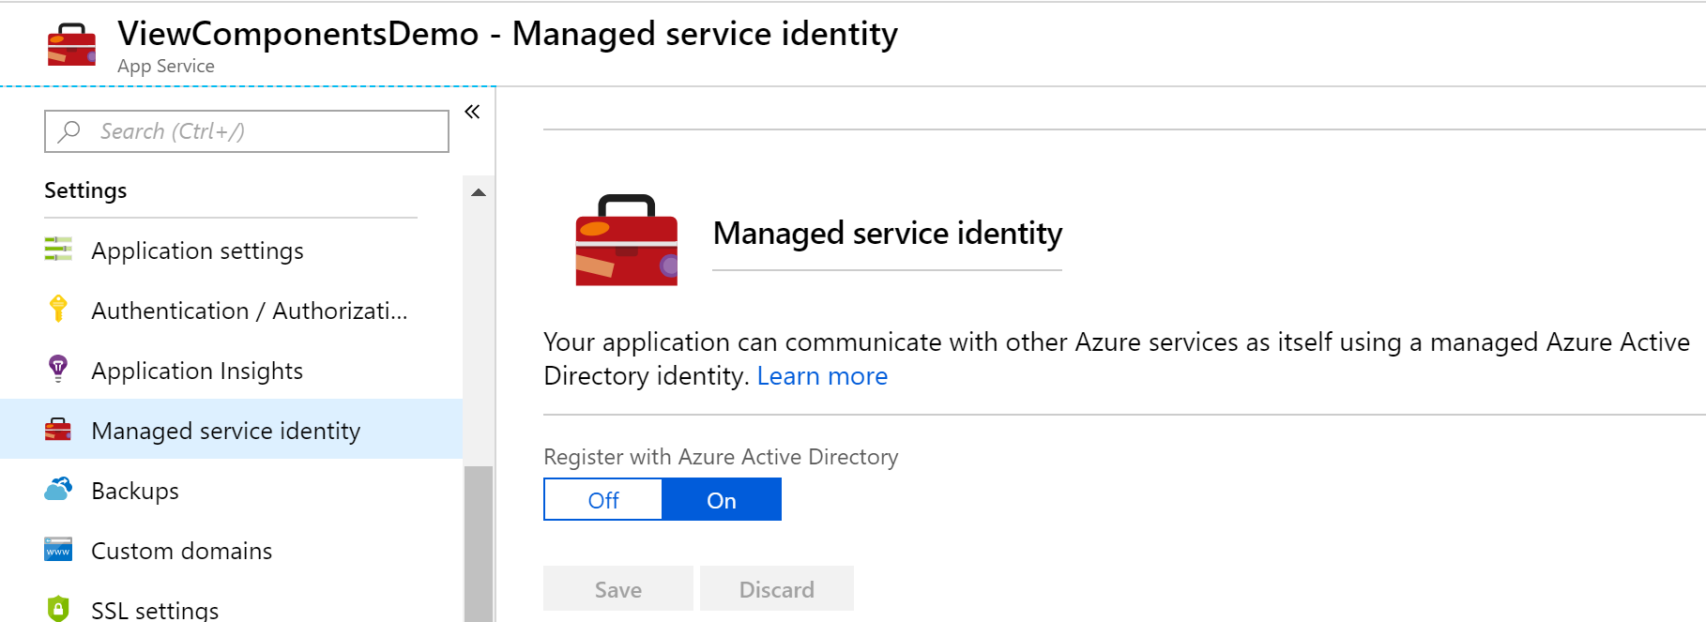
Key Vault: Configure access

Slide 16
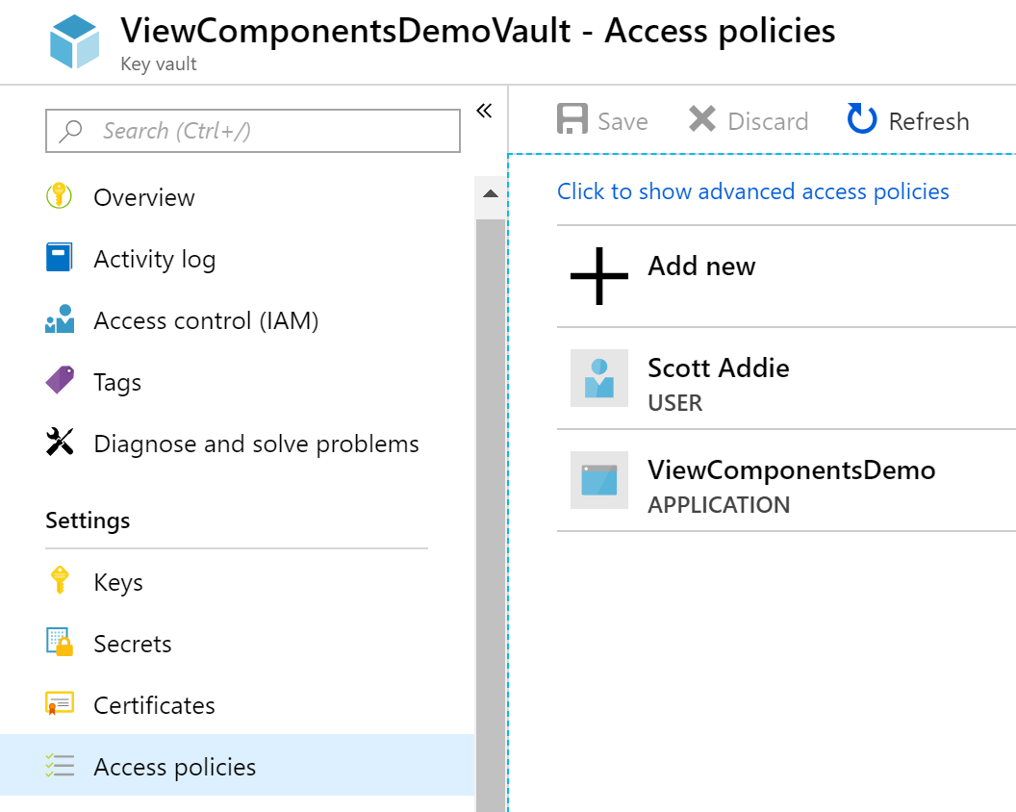
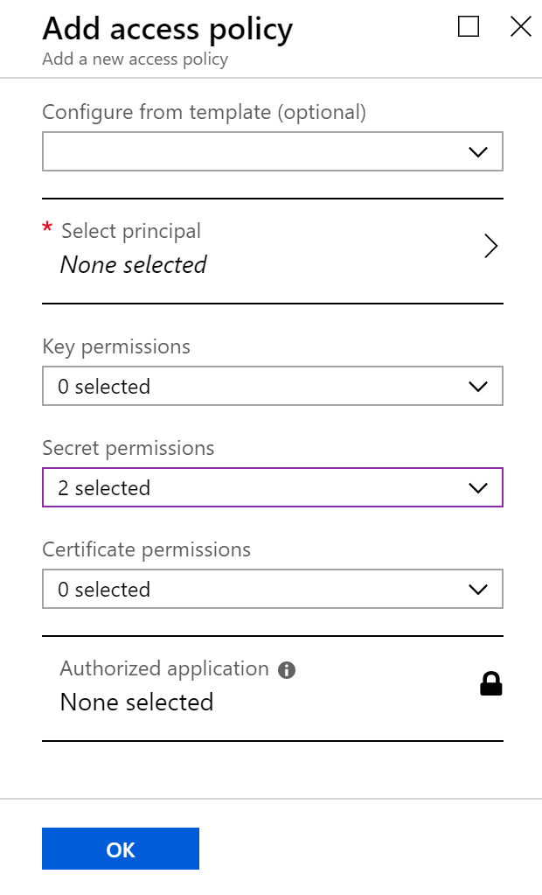
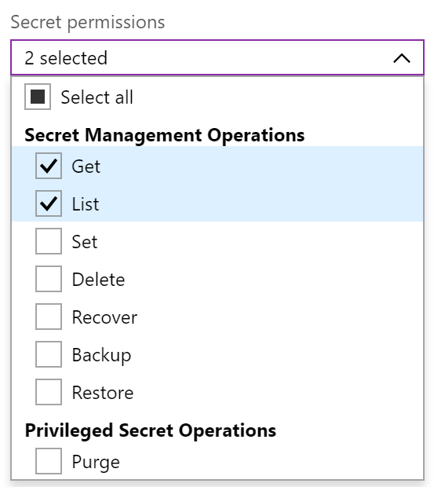
Key Vault: Configure access (cont.)

Slide 17
Comparison of solutions
 | Secret Manager | Azure Key Vault
Environments | Dev | Dev, Prod
Pricing | Free | $0.03 / 10k operations
Encryption | No | Yes
Storage | Local machine | Azure Storage

Slide 18


Demo
Secret Manager + Azure Key Vault

Slide 19


Resources
Docs @Scott_Addie
aka.ms/dotnet-secret-mgr
aka.ms/az-key-vault
Slides
aka.ms/app-secrets-slides
Code
aka.ms/app-secrets-code

